Slide 1
An Overview of The Ontario Community Health Profiles Partnership Project: Using Health Data for Planning
Website Demonstration for Ontario Health Central Region
Presentation for
Ontario Health Central Region October 18 2023
Notes:
AMT

Slide 2
Welcome and Introductions
Welcome by Ontario Health Central Region Team
Introductions – OH Central & OCHPP Teams
Outline of Today’s Presentation
Notes:
Maureen & Erin – Erin introduces OCHPP team who will be presenting

Slide 3
The OCHPP Team
Rick Glazier – Family Physician/Research Scientist – PI
Mohammad Agha – Epidemiologist/Data Analyst
Peter Gozdyra – Medical Geographer
Gary Moloney – GIS Specialist
Sher Khan – Web Developer
Leah Czukar – Data Analyst/GIS
Anne-Marie Tynan – Research Program Manager
Other Research Collaborators at MAP & Unity Healthy Toronto
Notes:
AMT – briefly mention the other team members

Slide 4
Outline of Today’s Presentation
What is the OCHPP?
Who are our partners and what are their roles?
What do we do? Where do we get our data?
How do we link “where you live” to your “health” data? – Geography 101
Overview of the website: Ontario Health Central Region Data & Maps
Notes:
AMT-Brief run down of the presentation

Slide 5
What is the OCHPP + Goal of OCHPP
The Ontario Community Health Profiles Partnership (OCHPP) makes high-quality, area-specific, health-related data available to everyone.
We do this through our open-access website and free health maps as well as partnerships with health-care and social-service organizations.
Notes:
AMT

Slide 6
The OCHPP Project … Background
Established in 1998 by Toronto Public Health, St. Michael’s Hospital, Community Health Agencies, City of Toronto
Other partners joined over time such as Ontario Health Central Region
Need for health data at local level among a variety of users and for a variety of topics in one place
Equity lens
Fun Fact: OCHPP is celebrating its 25th Anniversary Celebration in November 2023!
Notes:
AMT

Slide 7
The OCHPP Project … Background
Public website established in 2005 to post data and allow free access
Average number of monthly visits: 1800
Total # of partners & collaborators: 16
Total # of students over the years: 20+
Total # of special requests: 5+ each year
Fun fact: dozens of maps created every year
Notes:
AMT

Slide 8
OCHPP Partners & Collaborators
Partners
Ontario Health Toronto Region
Ontario Health Central Region
ICES
St. Michael’s Hospital
Toronto Public Health
City of Toronto – Wellbeing Toronto
Access Alliance Community Health Centre
Wellesley Institute
Health Commons Solutions Lab
ConnexOntario
Ottawa Neighbourhood Study
Region of Peel
Collaborators
University of Toronto – Faculty of Medicine
Toronto & Region Conservation Authority
Inspire-PHC
Canadian Health Workforce Network
Notes:
AMT

Slide 9
Partners - Roles
Paying Partner ($)
Collaborative Partner (Meeting Space, Mutual Projects)
Data Partner (XYZ123)
Notes:
AMT

Slide 10
Where Do We Get Our Data? Data Sources
Indicator:
Health
Socio-Demographic
ICES (through a partnership)
Statistics Canada (open source)
Source:
Origin:
Health databases
Census of Population
Data Set(s):
Registered Persons Database (your health card) + other data sets
Census variables
Other data sources
ConnexOntario - alcohol and gambling-related data
Partner-shared data such as surveys
Notes:
Gary

Slide 11
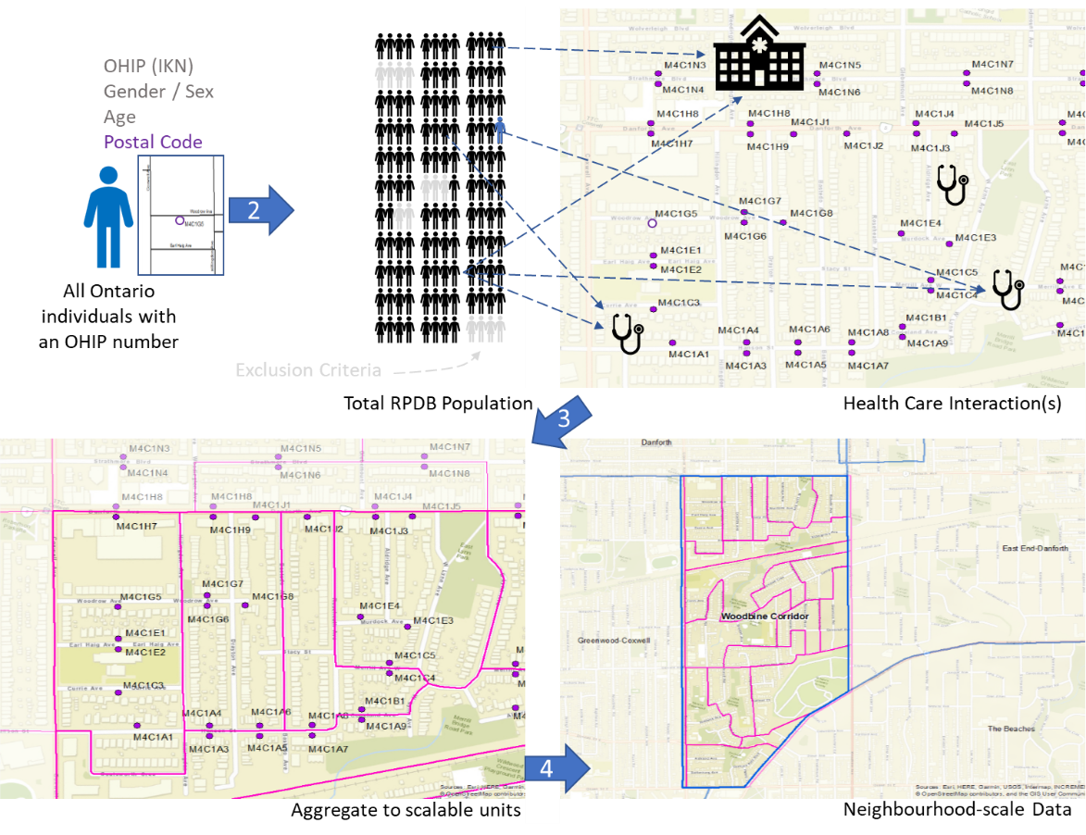
Linking a “Person & Place”- Population Source
Notes:
Gary

Slide 12
Ontario Health Central Region and OCHPP
In 2022 a collaborative project was established between OH Central and OCHPP to create a set of Local Areas (LAs) within OH Central.
Over the last year, the OCHPP and OH Central teams created 194 new LAs covering the area of OH Central Region.
The 194 LAs comprise over four million people who reside in the fast-growing and diverse communities from Mississauga to Huntsville and Orangeville to Markham.
Notes:
Xun

Slide 13
The OCHPP Website – Live Demonstration
www.OntarioHealthProfiles.ca
Notes:
Peter and Gary

Slide 14
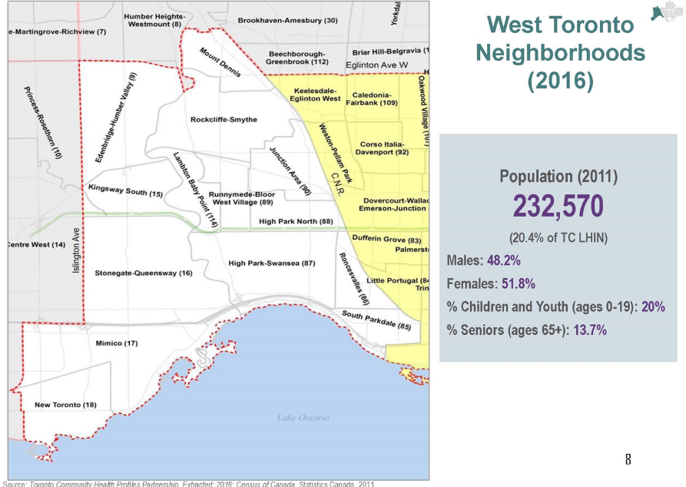
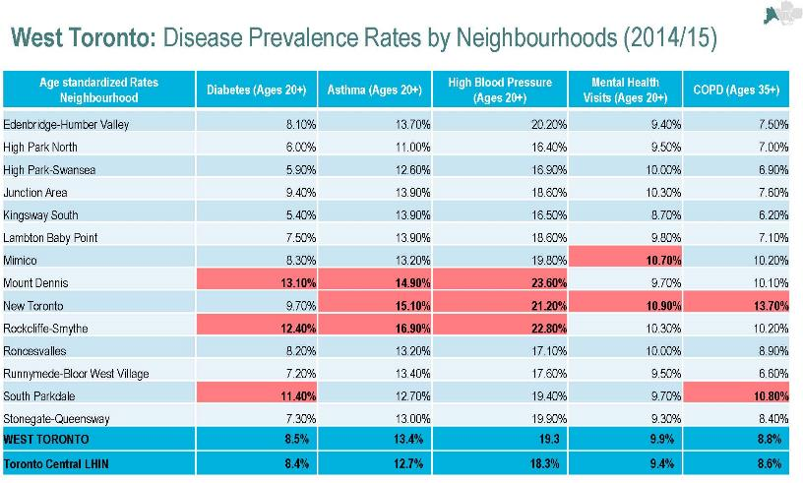
OCHPP Data in Health Policy and Planning-Toronto
Notes:
Gary

Slide 15
Ontario Health Central Region’s Data Sample
Notes:
Xun

Slide 16
What’s Next?
Adult Health & Disease Indicators (Diabetes, Asthma, High Blood Pressure, COPD, MH and Addiction-Related Visits to a Primary Care Provider)
All Hospital Admissions (Medical, Surgical, MHA-Related, Obstetric-Related, ALC and more)
Emergency Department Visits (High, Low Urgency EDV, MHA EDV)
Prevention (Cancer Screening)
Primary Care Workforce Profiles (Census of Family Physicians Providing Comprehensive Primary Care)
Custom Geography Functionality & Interactive Maps
Additional Workshops
Sign-up to our Subscriber’s List!
Notes:
AMT – mention link to slides will be on OCHPP website

Slide 17
Thanks for Listening! Any Questions?

